Slide 1
What are patterns – Part III?
Patterns as a Roadmap
in complex designs

Slide 2

Exercise
Why do we then need design patterns when most of then are simply the application of three fundamental principles?
Henrik Bærbak Christensen

Slide 3
Answer
For defining a terminology of why we have used the principles in this way!
  for documentation purposes
  for use during design discussions
  for finding our way in a big mess of classes !
Henrik Bærbak Christensen

Slide 4
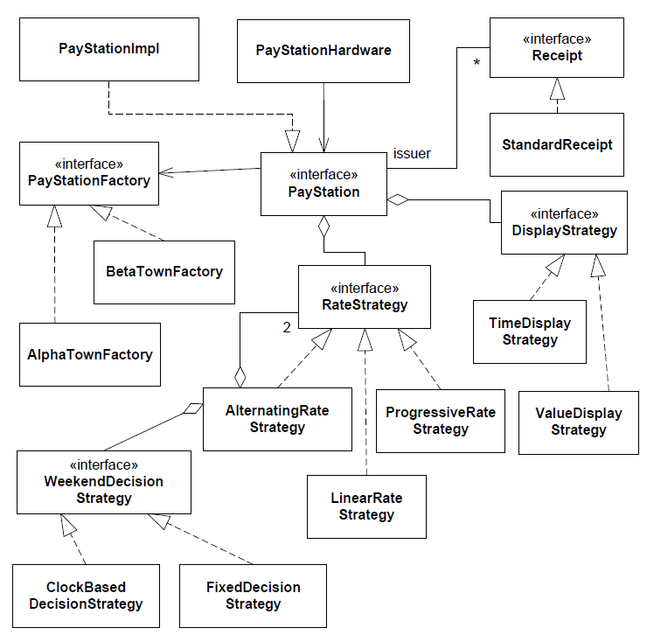
Example
What a mess !!!
Henrik Bærbak Christensen

Slide 5
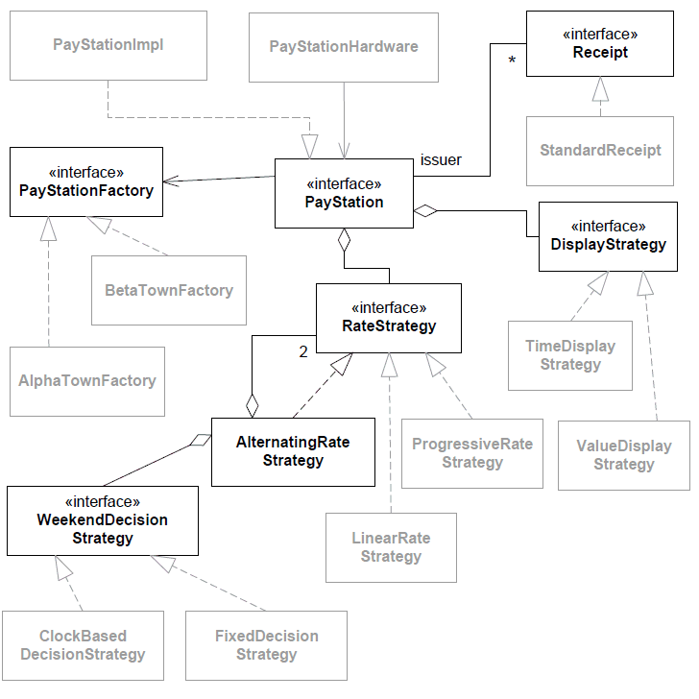
Patterns for sense-making
Patterns define the road map for all the implementation classes. Thus we maintain overview!
Henrik Bærbak Christensen

Slide 6

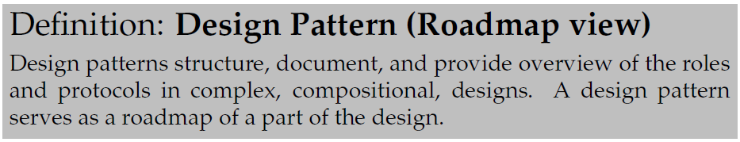
Yet another definition
Henrik Bærbak Christensen

Slide 7
Patterns
Basically patterns classify and document how the principles have been applied – they provide the link between the solution and the problem
Thus it is important – in my view – to include the pattern name in the interface/class names
... and describe the roles in the API documentation (JavaDoc, etc.)
Beware of programmers that are not trained in patterns. They do see a big mess! And make one!!!
Henrik Bærbak Christensen

Slide 8
... but
Of course this is a bit of an over-generalisation.
Some patterns are more complex and have more explicit behavioural constraints
  Visitor, Observer, Mediator, etc.
However, you will see the principles in action even in these patterns...
Henrik Bærbak Christensen

